Slide 1
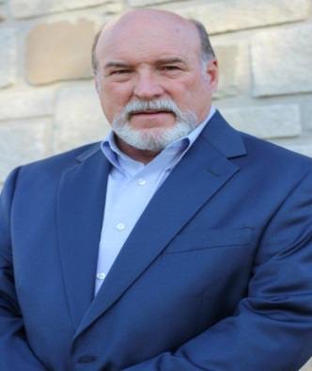
Elect Leon Warner
Creek County Commissioner
* Thank you for your support
* 4th generation life long Creek County Resident
* Demonstrated Integrity
* Conservative Republican record
* 34 years of proven business leadership
* Read more about my background and thoughts on Facebook
* Facebook: Leon Warner for County Commissioner
* Warnerforcountycommissioner@gmail.com
* Primary Election is on Tuesday, June 28, 2016

